Slide 1
NOP COMMERCE WEBSITE AUTOMATION
UNDER GUIDANCE OF VAISHALI MAM

Slide 2
INTRODUCTION
Purpose : To perform Automation testing on NopCommerce Website.
Automation testing uses tools and scripts to validate functionality.
For NopCommerce automation testing ensures :
Scalability
Consistency
Faster Execution
Time Management

Slide 3
OVERVIEW
NopCommerce website provides products which includes laptops, electronics and more.
Key Features Automated :
User login and authentication
Product search
Adding/ removing items from cart
Adding Products to the Wishlist
New Products Availability
Conversion of Currency
Blog Observation
Applying Filters Based On the Prizes and Alphabetics.

Slide 4
Modules
Module 1 : Register Page and Login Page
Check All the functionalities on the Register Page which included:
Entering credentials
Validating login functionality
Verifying error messages for invalid credentials
Ensuring Forgot password links work properly
Module 2 : Search Functionality
Check All functionalities related to product search which included :
Validating search results
Working of filter
Navigation of product pages from search
Module 3 : Cart Functions
Check All functionalities related to cart which included :
Adding products to cart
Verifying product details in cart
Removing items from cart

Slide 5
Modules
Module 4 : Adding the products to The Wishlist
Check all functionalities related to adding the products to the wishlist
Searching a Particular Product need to added to the Wishlist
Add the product to the wishlist
Check in the Wishlist Weather the product is present or not
Module 5 : New Products Availability
Checked all functionalities related to The New Products Availability :
Check in the New Products Section Which is Present in the Footer It Shows all the New Products
Module 6 : Currency Conversion
Checked all functionalities related to Currency Conversion
Searching a Particular Product need to Buy
Select Required Currency in this Website Doller and Euro is Available in Drop down For Particular Product
Module 7 and 8 : Blog Observation and Applying Filters Based On the Prizes and Alphabetics
Checked all functionalities related to Blogs and Prizes Order:
Searching a Particular Product need to Buy and Order them in Ascending and Descending Based on the Prizes and Alphabetics.
Check the Blog Functionality.

Slide 6
DEFECTS
A defect occurs when the actual result of a test case does not match the expected result. So created defect report on it.

Slide 7
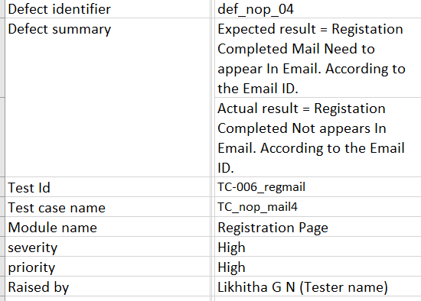

Slide 8
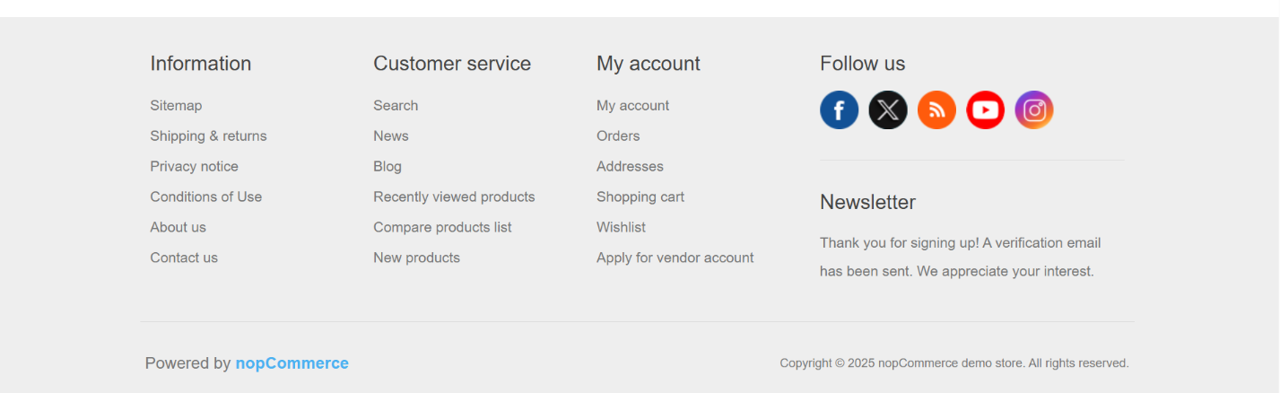
Only Here we can see

Slide 9
FRAMEWORKS USED
Cucumber (BDD) – Behavior Drivenn Development
Selenium WebDriver – Broswer Automation
Jenkins – Continuous Integration / Continuous Delivery

Slide 10
TEST SCENARIOS AUTOMATED
Register Feature
Login Feature
Search Feature
Sort By Feature
Add to Cart Feature
Remove from Cart Feature
Wishlist Feature
New Product Feature
Change Currency Feature

Slide 11
EXECUTION PROCESS
TestCases Written in feature Files and Step Defnition Formats.
Test Runner to Used to Perform Integration Testing.
HTML,JSON and JUNIT Reports are Generated.
Run In the Jenkins to Check the Functionality.
BENEFITS OF BDD
Easy to understand feature files (Human Readable Language)
We can do Data Driven Testing using Feature Files with Scenario Outline
Code reusability

Slide 12
CHALLENGES
Handling Exceptions like Element Not Interactable, Not Clickable
Managing synchronization between Feature files
Adding Dependencies According Java versions in POM File.

Slide 13
EXPERIENCE
Gained hands on experience with Cucumber BDD Framework.
Writing scenarios in Gherkin.
Got to know how to handle waits and priorities.
Understood real time challenges of web testing such as element visibility.
Improved debugging skills and Technical Skills.
Gained experience on Jenkins while creating pipeline which tiggers automatically.

Slide 14
THANK YOU

